Slide 1
Portfolio Optimizing Using Deep Learning
Krishna Kumar Shrestha
Middle Tennessee State University

Slide 2
Agenda
Introduction
Basic Terminology
Traditional Methods
Transformer
Performer
Conclusion
Limitations and future works

Slide 3
What Investors Look For?
Expected Return
Risk Tolerance
Diversification
Liquidity Needs
Time Horizon
Notes:
Expected Return: Investors aim to maximize the growth of their capital over time
Risk Tolerance: The degree of variability in returns that investors are willing to accept
Diversification: Spreading investments across assets to reduce unsystematic risk
Liquidity Needs: Ensuring assets can be bought or sold without significant price impact.
Time Horizon: Aligning asset choice with investment duration and goals.

Slide 4
The Challenge Facing Rational Investors
In a given market, an investor is presented with different assets/securities with different levels of return based on the underlying risk.
A practical consideration rational investors face is how best to select the asset or combination of assets or security investments that present an optimal balance between risk and return on investment and maximizes their expected utility.

Slide 5
Key Terminology: Systematic Vs Unsystematic Risk
Systematic Risk also called market risk is driven by macroeconomic and market wide factors and cannot be diversified away
Unsystematic risk, also known as specific or diversifiable risk, arises from factors unique to a single company or industry and can largely eliminated by holding a well-diversified portfolio

Slide 6
Key Terminology: Efficient Frontier
The set of all portfolios that offer the highest expected return for a given level of risk ( or the lowest risk for a given return), forming a convex curve in risk-return space
Expected Return
Efficient Frontier
Portfolios
Standard Deviation

Slide 7
Key Terminology: Capital Market Line
A straight line from the risk-free rate to the market portfolio, representing the best possible risk-return trade-off when a risk-free asset is available
Expected Return
Efficient Frontier
Capital Market Line
Portfolios
Standard Deviation

Slide 8
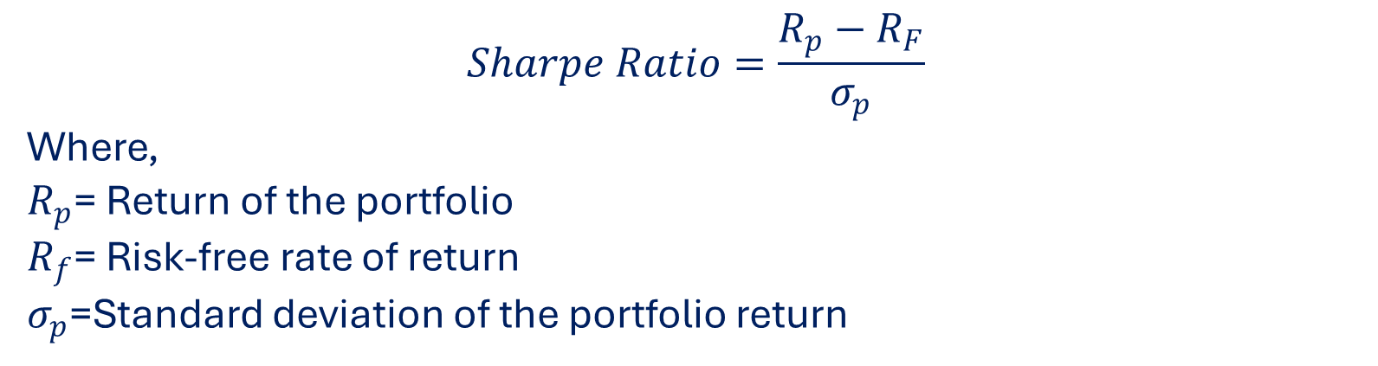
Key Terminology: Sharpe Ratio
A measure of risk‑adjusted return calculated as (portfolio return – risk‑free rate) divided by portfolio standard deviation;
$$Sharpe Ratio=\frac{R_{p}−R_{F}}{σ_{p}}$$
Where,
$R_{p}$= Return of the portfolio
$R_{f}$= Risk-free rate of return
$σ_{p}$=Standard deviation of the portfolio return

Slide 9
Modern Portfolio Theory Overview
Origin: Developed by Harry Markowitz in 1952; Nobel Prize in Economics,1990
Core Principle : An assets contribution to portfolio risk matters more than its standalone risk.
Key inputs:
Expected return
Risk
Correlations between asset returns

Slide 10
Assumptions of Modern Portfolio Theory
Markets are efficient, and investors have access to all the available information regarding the expected return, variances, and covariances of securities or assets.
Investors are risk-averse, i.e., they will tend to avoid unnecessary risks.
Investors are non-satiated, i.e., given two securities with the same standard deviation, an investor would choose the highest expected return.
There is a fixed single-time horizon.
There are no taxes or transaction costs.
Assets can be held at any amount.
A risk-free rate of return exists in the market, and unlimited capital can be borrowed or invested at this rate.
Investors make their decisions solely based on expected returns and variance.
Notes:
Markets are efficient, and investors have access to all the available information regarding the expected return, variances, and covariances of securities or assets.
Investors are risk-averse, i.e., they will tend to avoid unnecessary risks. For example, investors choose to invest in bank deposits that pay lower returns but guaranteed returns rather than investing in stocks that may promise high returns but carry a high risk of losses.
Investors are non-satiated, i.e., given two securities with the same standard deviation, an investor would choose the highest expected return.

Slide 11
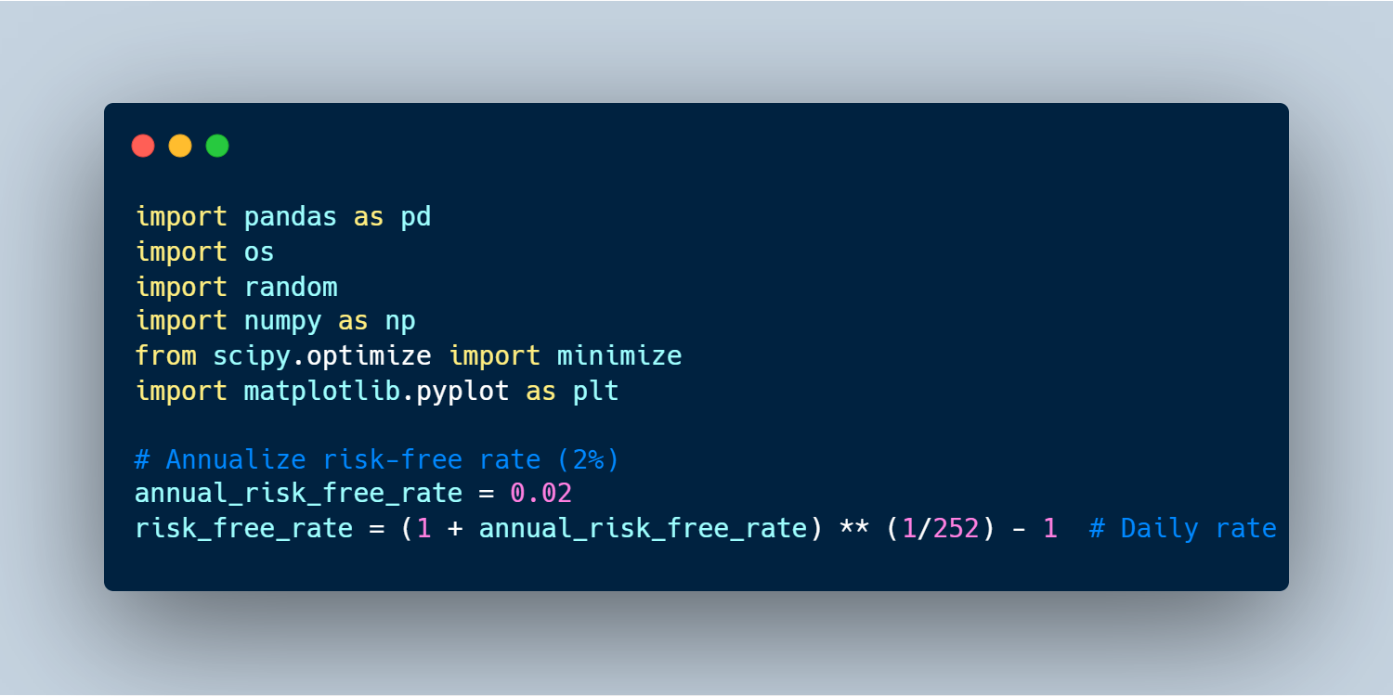
Python Coding : Imports and Configuration

Slide 12
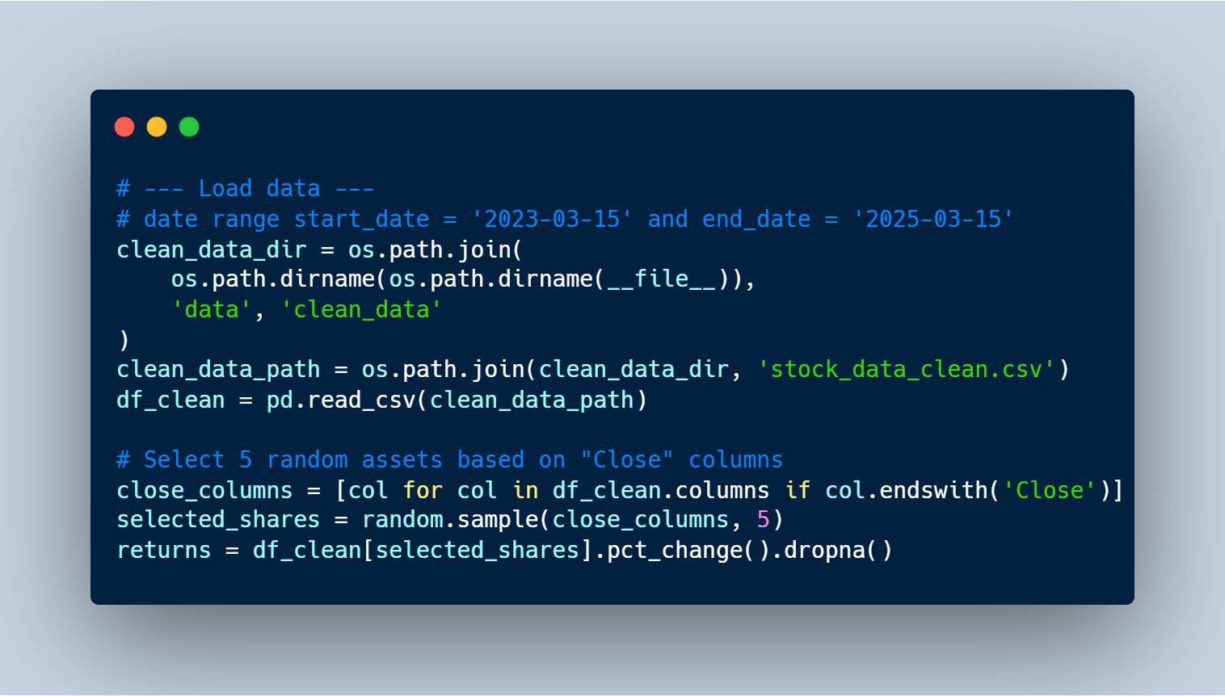
Python Coding : Data Loading

Slide 13
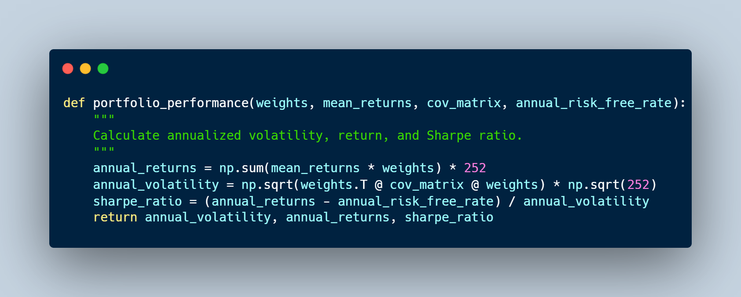
Python Coding : Portfolio Performance Function

Slide 14
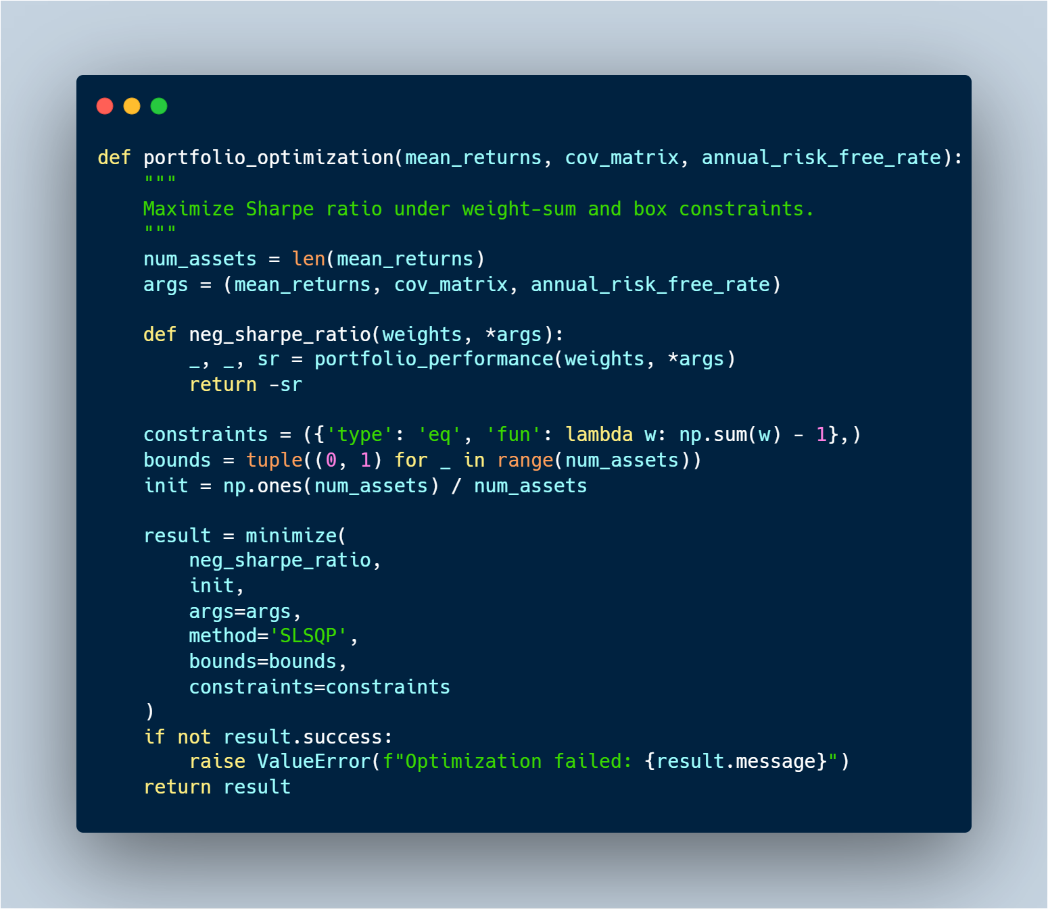
Python Coding : Sharpe-Ratio Maximization

Slide 15
Python Coding : Sharpe-Ratio Maximization

Slide 16
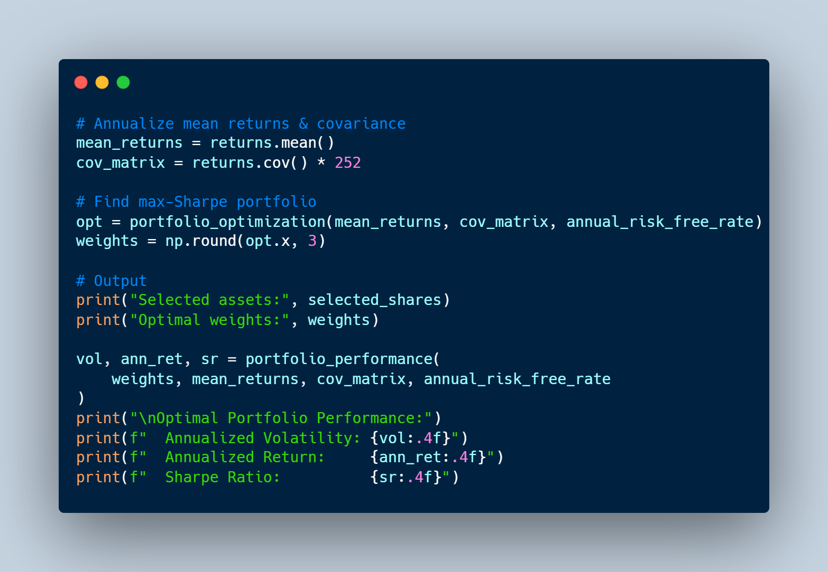
Python Coding : Run Optimization & Display Results

Slide 17
Results

Slide 18
Results

Slide 19
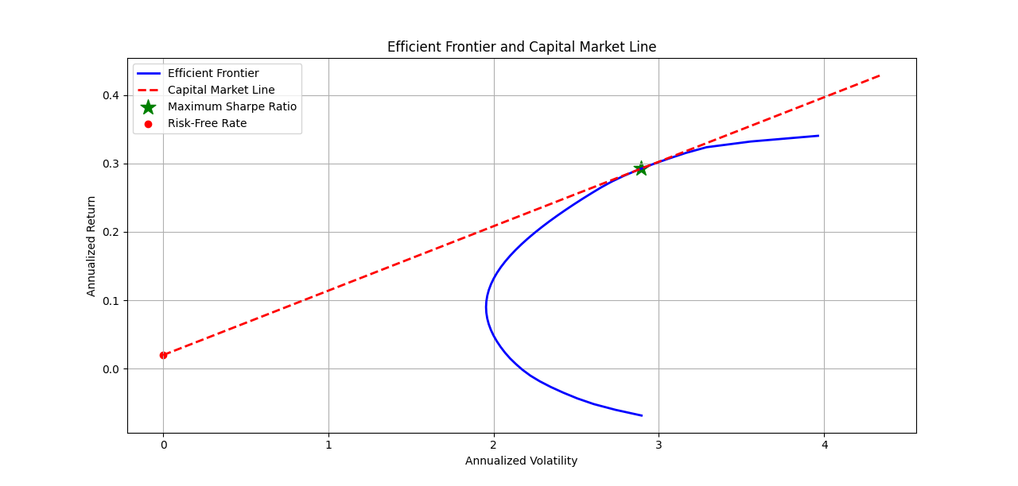
Results

Slide 20
Unrealistic Assumption
Use of Deep learning to solve few of these issues

Slide 21
High Level Overview :Transformer
Transformer
Input
Output

Slide 22
High Level Overview :Transformer
Output
Transformer
Encoder
Decoder
Input

Slide 23
High Level Overview :Transformer
Output
Transformer
Encoder
Decoder
Encoder
Decoder
Encoder
Decoder
Encoder
Decoder
Encoder
Decoder
Input

Slide 24
High Level Overview :Transformer
Encoder
Feed Forward Neural Network
Self Attention
Input

Slide 25
High Level Overview :Transformer
Output
Encoder
Decoder
Feed Forward
Feed Forward Neural Network
Encoder-Decoder Attention
Self Attention
Self Attention
Input

Slide 26
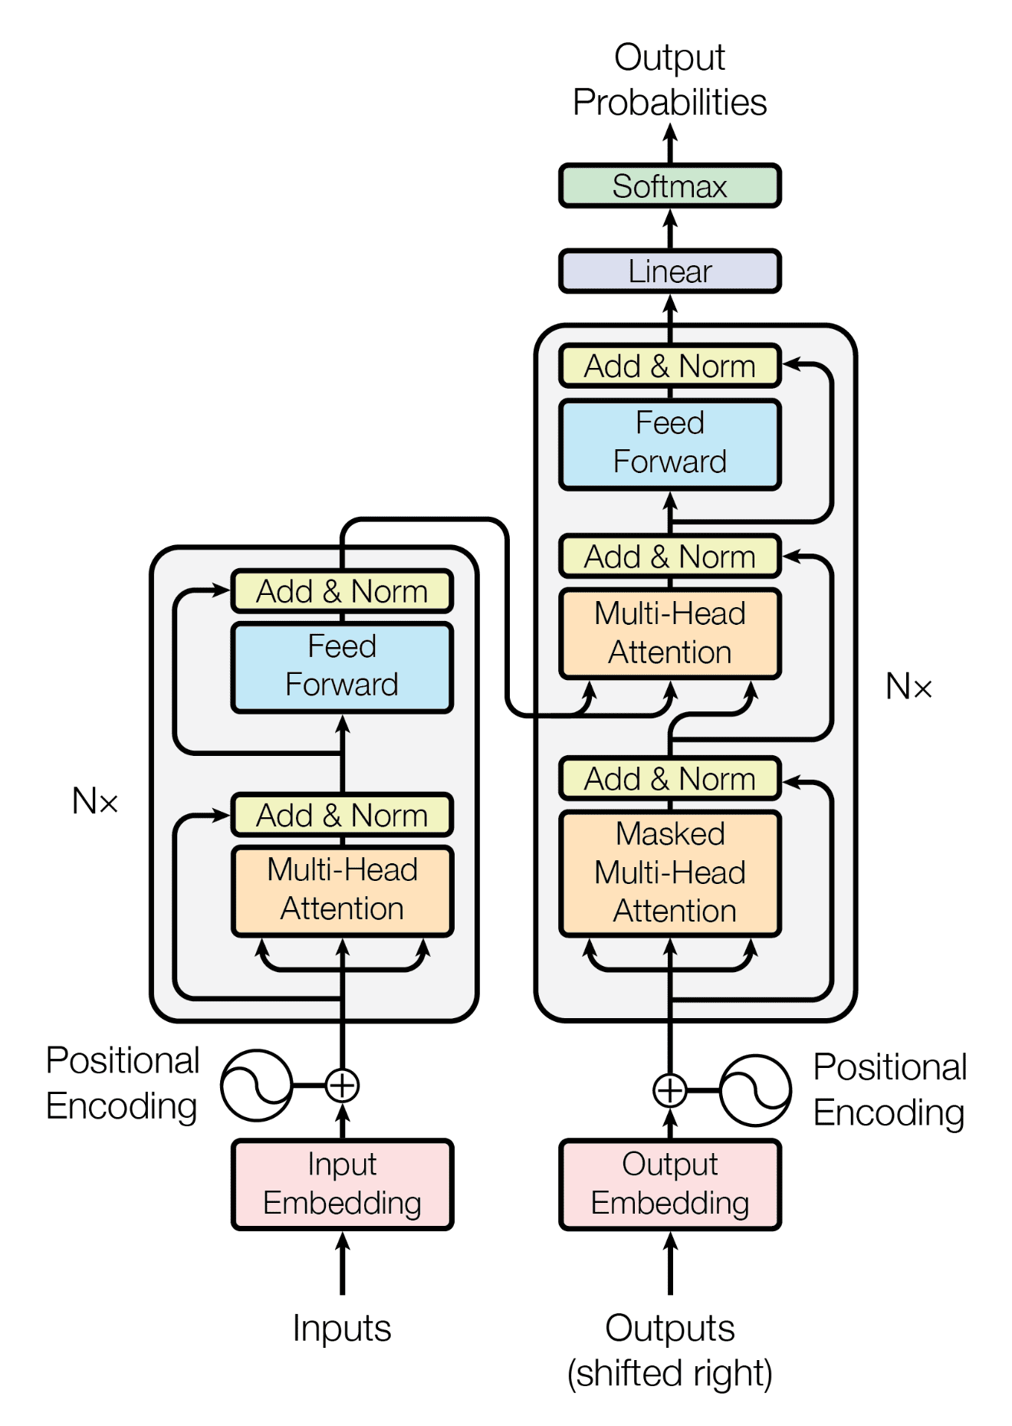
Full Agriculture
Feed-forward Network:
After taking information from other tokens, take a moment to think and process this information
Feed-Forward Network
After taking information from other tokens, take a moment to think and process this information
Decoder-encoder attention :
Target token looks at the source
Queries-from decoder states; keys and values from encoder states
Encoder self attention:
tokens look at each other
Queries, keys, values are computed from encoder states
Decoder self-attention :
Tokens look at the previous tokens
Queries, key, values are computed from decoder states

Slide 27
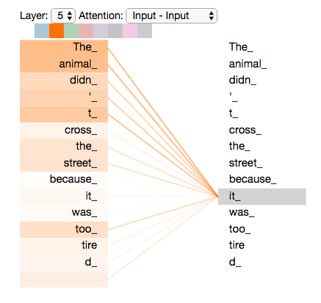
Self Attention
The animal didn't cross the street because it was too tired.
https://jalammar.github.io/illustrated-transformer/

Slide 28
Idea Behind Attention
Goal : Learn (differentiable) how to pick relevant information from input data
Create three vectors from each of the encoders input values (query, key, value)
Calculate a score for how much to focus on each part of the input when we encode words at specific positions
How?
Actual math on the report, but the idea is to select a value (referenced by a key) relevant to a query ( what trying to pull from input)

Slide 29
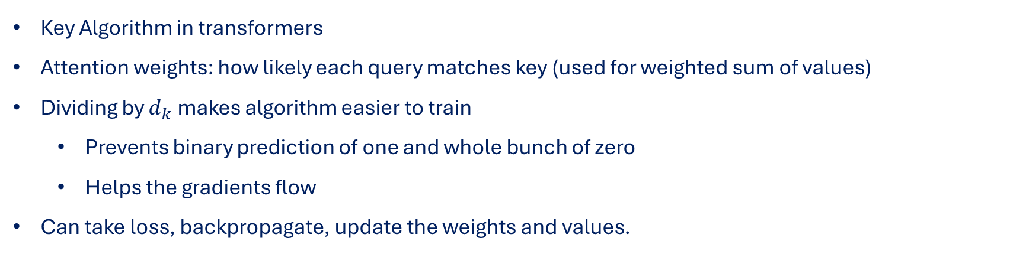
Scaled Dot Product Attention
Key Algorithm in transformers
Attention weights: how likely each query matches key (used for weighted sum of values)
Dividing by $d_{k}$ makes algorithm easier to train
Prevents binary prediction of one and whole bunch of zero
Helps the gradients flow
Can take loss, backpropagate, update the weights and values.

Slide 30
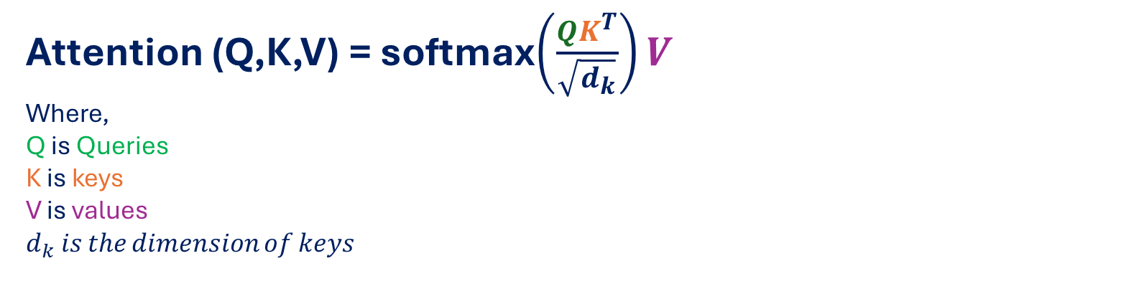
Scaled Dot Product Attention (Continued)
Attention (Q,K,V) = softmax$\left(\frac{QK^{T}}{\sqrt{d_{k}}}\right)V$
Where,
Q is Queries
K is keys
V is values
$d_{k}$ 𝑖𝑠 𝑡ℎ𝑒 𝑑𝑖𝑚𝑒𝑛𝑠𝑖𝑜𝑛 𝑜𝑓 𝑘𝑒𝑦𝑠

Slide 31
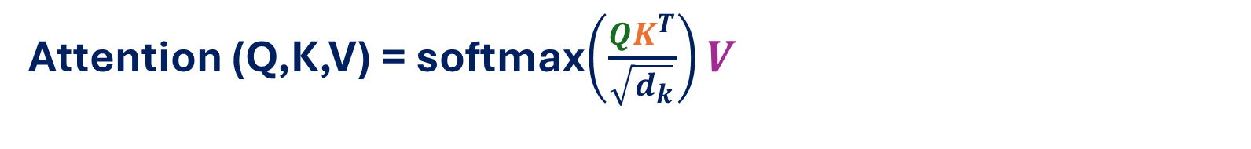
Scaled Dot Product Attention (Continued)
Attention (Q,K,V) = softmax$\left(\frac{QK^{T}}{\sqrt{d_{k}}}\right)V$
Q
K
V

Slide 32
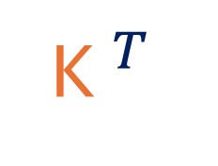

Scaled Dot Product Attention (Continued)
Attention (Q,K,V) = softmax$\left(\frac{QK^{T}}{\sqrt{d_{k}}}\right)V$
Q
K$^{T}$
V
Z
Softmax
$$d_{K}$$

Slide 33
Performer
Is a specific type of transformer designed to improve the scalability of attention through Fast Attention via Positive Orthogonal Random Features (FAVOR+).

Slide 34
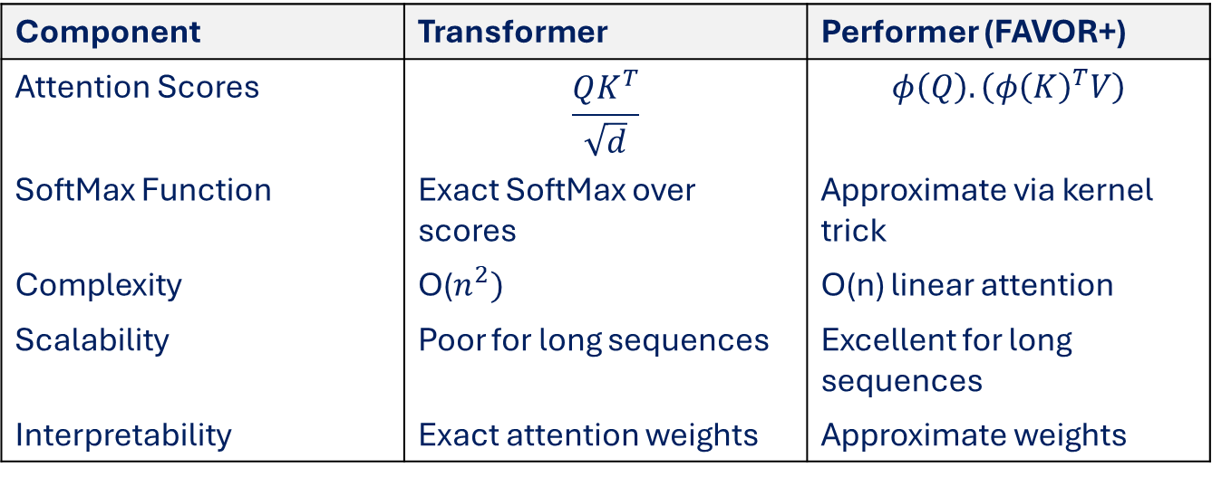
Comparison: SoftMax vs Kernel Approximation
Component | Transformer | Performer (FAVOR+)
Attention Scores | $$\frac{QK^{T}}{\sqrt{d}}$$ | $$φ\left(Q\right).\left(φ{\left(K\right)}^{T}V\right)$$
SoftMax Function | Exact SoftMax over scores | Approximate via kernel trick
Complexity | O($n^{2})$ | O(n) linear attention
Scalability | Poor for long sequences | Excellent for long sequences
Interpretability | Exact attention weights | Approximate weights

Slide 35
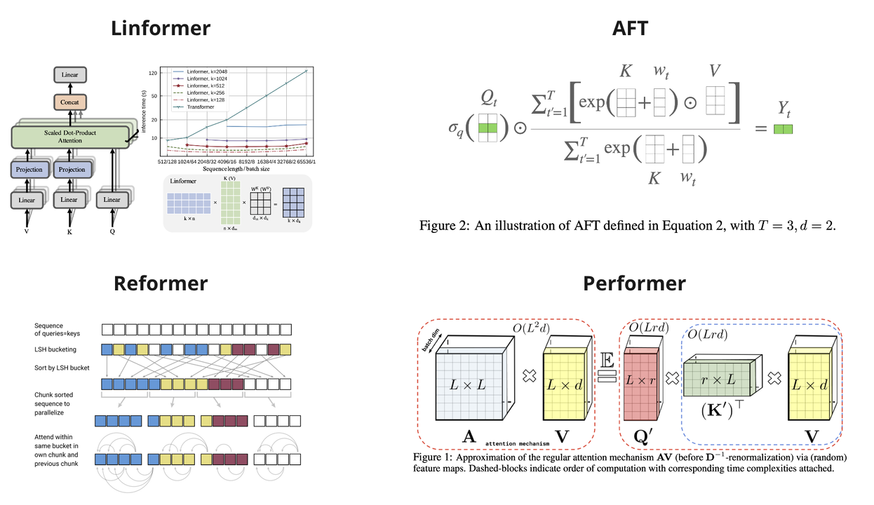

Slide 36
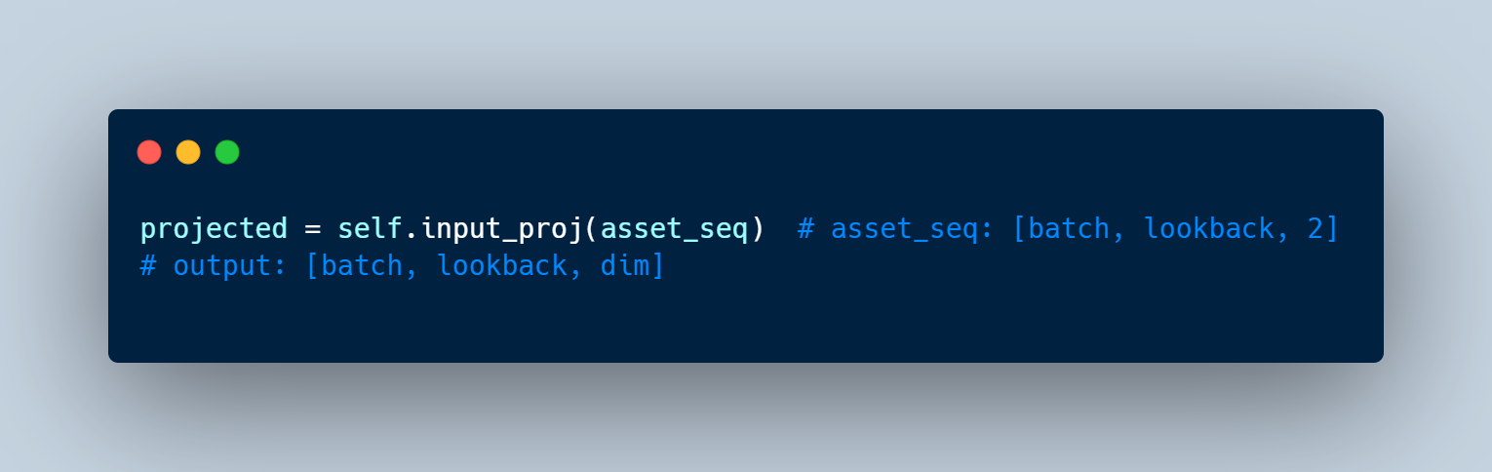
Step 1 : Encoding layer
Each assets time series is passed through a linear encoder to project from 2D( price & volume) to a higher-dimensional space
🧠 Why? A higher-dimensional space allows the attention layer to better capture complex temporal patterns.

Slide 37
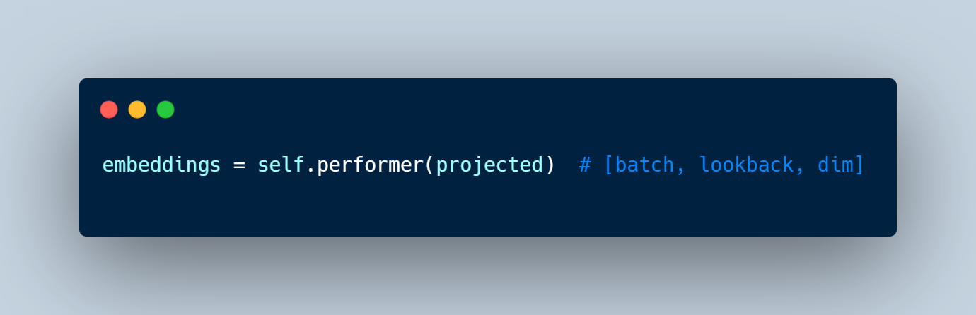
Step 2 : Attention Layer (Performer)
The encoded sequence is then passed through the Performer attention module.
🧠 Why? Attention helps the model learn what historical points are important for each asset.

Slide 38
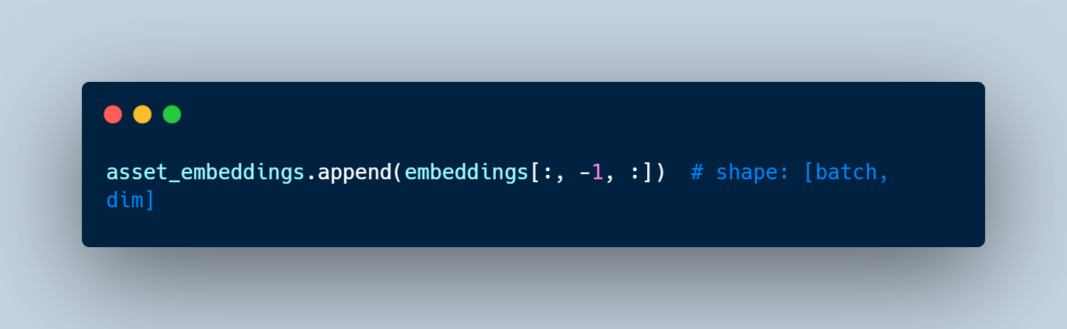
Step 3 : Extract Final Embedding
From the attention output, we only keep the last time step embedding (latest info).
🧠 Why? Only the most recent context matters for today’s investment decision.

Slide 39
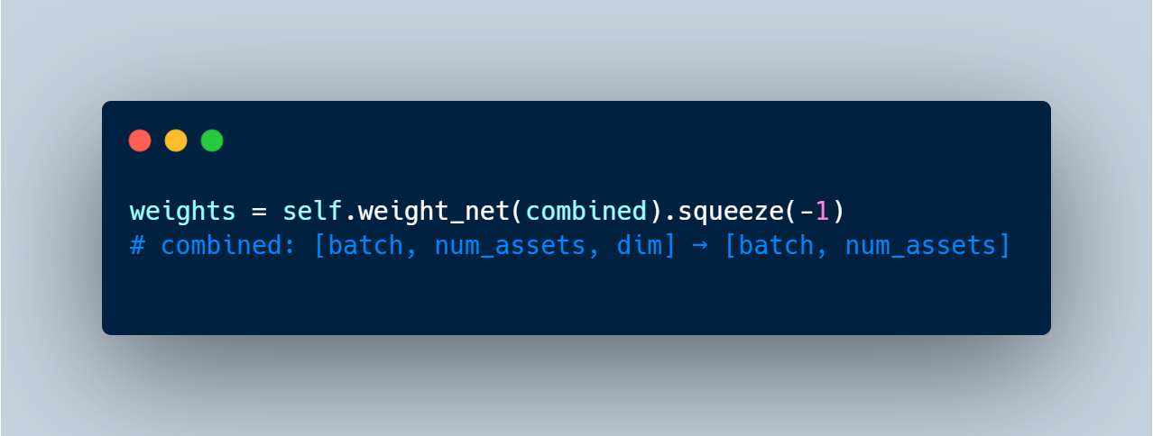
Step 4 : Forward Network (Scoring Layer)
Each asset’s final embedding goes through a small neural network to get a raw score.
🧠 Why? Translates complex patterns into a decision signal for each asset.

Slide 40
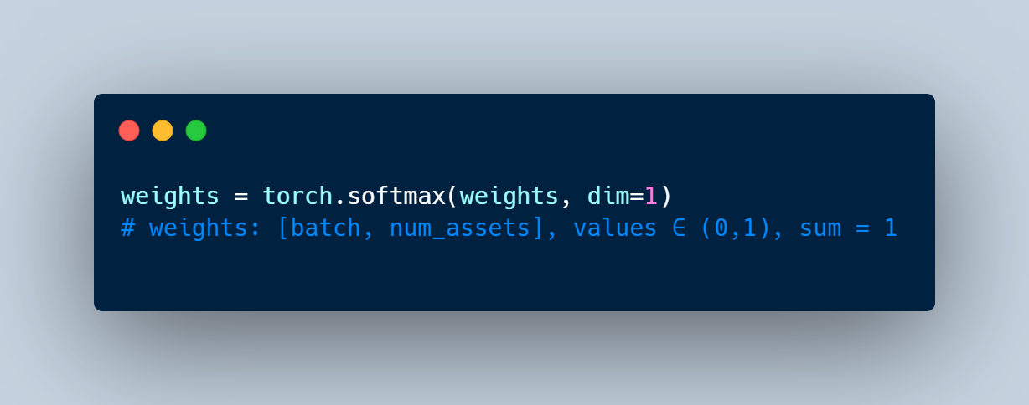
Step 5: Decoder (Softmax Layer)
The scores are normalized using softmax to ensure they sum to 1—forming a valid portfolio.
🧠 Why? Final weights must represent proportions in a portfolio (like 30% in asset A, 25% in B, etc.)

Slide 41
Output

Slide 42
Output

Slide 43
Conclusion
The Performer model demonstrated superior performance compared to traditional Portfolio optimization technique. By replacing the SoftMax attention mechanism with a kernel-based approximation (FAVOR+), Performer achieved significantly lower computational complexity and memory usage. This made it especially effective for handling long sequences and high-dimensional financial time series data. Additionally, the model produced a higher Sharpe ratio, indicating improved portfolio return consistency and risk-adjusted performance. Overall, the Performer offers a scalable and efficient alternative for portfolio optimization tasks in environments where speed and stability are critical.

Slide 44
Limitation and Future work
⚙️ Limited Hardware:
The model was trained on a personal computer without GPU acceleration, leading to longer training times and limited ability to scale.
🧠 Model Complexity vs. Resources
Due to computational limitations, hyperparameter tuning (e.g., Performer depth, head size, dimension) was not extensively explored, potentially limiting model performance.
📆 Limited Historical Data
Only 2 years of historical data were used, which may not fully capture long-term market cycles or structural shifts.

Slide 45
Reference
https://research.google/blog/reformer-the-efficient-transformer/
https://research.google/blog/rethinking-attention-with-performers/
https://doi.org/10.48550/arXiv.1706.03762

